Slide 1
Detect the important features for glucosinolate?????

Slide 2
What is the active part in black mustard??
And what is the active constituent in it???

Slide 3
I am confused how can I get mustard oil??
Its like olive oil or not ?????
Which is the active constituent in white mustard???
And what is the important of myrosinase????

Slide 4
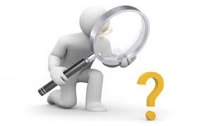
The active constituent in garlic is s-glycoside???
What is the important of Brassica family give example about it????

Slide 5
What is the difference between Allin & Allicin???
How can you detect garlic activity?????
How you can detect this garlic contain hight amount of allicin????
What is the difference between fresh & coked garlic ?????
There is any different between pharmaceutical product of garlic in pharmacy? If your answer yes can you tell me why????????

Slide 6
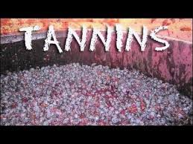
Tannins :
Tannins are polyphenolic compounds that are difficult to separate because they do not crystallized Because of this difficulty in separation they are called tannin extract.
Detection :
1-qualitative:
They have the ability to precipitate proteins ,So we use (Goldbeater’s test) to detect tannins qualitatively
2- quantitative:
the mechanism of detection is by adsorption on a standard hide-powder.

Slide 7
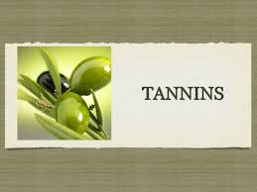
Tannins classification :
Due to the enormous structural diversity of the tannins a systematic classiﬁcation system based on speciﬁc structural characteristics and chemical properties would provide a convenient framework for further study.
The tannin compounds can be divided into two major groups based on Goldbeaters skin test. A group of tannins showing the positive tanning test may be regarded as true tannins while those, which are partly retained by the hide powder and fail to give the test, are called as pseudotannins.

Slide 8
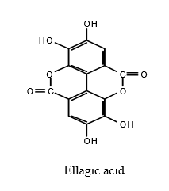
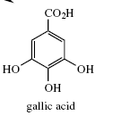
True tannins can be classified to :
Hydrolysable Tannins: As the name implies these tannins are hydrolysable by mineral acids or enzymes such as tannase. Their structures involve several molecules of polyphenolic acids such as gallic, and ellagic acids, bounded through ester linkages to a central glucose molecule.
The ester linkage readily hydrolyzed to yield phenolic acid & sugar
phenolic acid + sugar

Slide 9
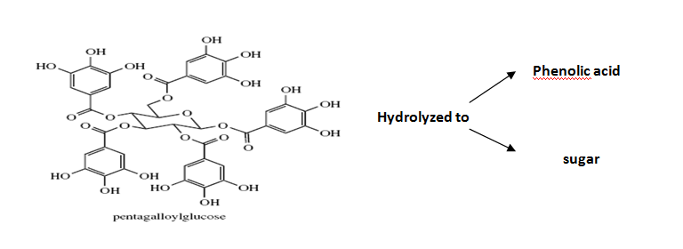
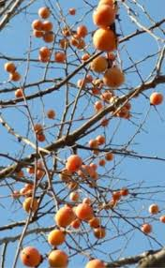
The hydrolysable tannins are soluble in water and their solution produces blue color with ferric chloride.

Slide 10
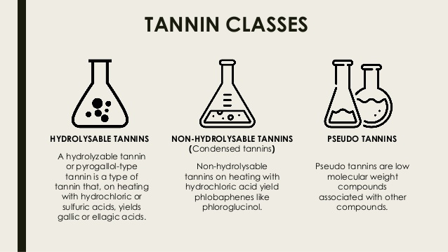
Non-hydrolyzable tannins or Condensed tannins : They are not hydrolyzed readily to a simpler molecules & they don’t contain sugar moiety. When treated with acids or enzymes, they tend to polymerise yielding insoluble red colored products known as phlobaphens.
The families of the plants rich in both of the above groups of tannins include Rosaceae, Geraniaceae, Leguminosae, Combretaceae, Rubiaceae, Polygonaceae, Theaceae etc. The members of families Cruciferae and Papaveraceae on the other hand are totally devoid of tannins. In the plants in which tannins are present, they exert an inhibitory effect on many enzymes due to their nature of protein precipitation and therefore contribute a protective function in barks and heartwood.
Complex tannins: They are biosynthesized from both hydrolysable & condensed tannins .

Slide 11
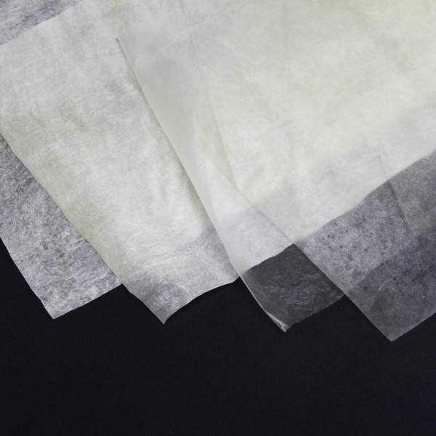
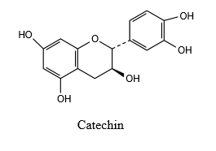
Pseudotannins: They are simple phenloic compounds with melting point lower than that of true tannins & they do not respond to tannic test, Pseudotannins are simple phenolic compounds of lower molecular weight. They do not respond to the tanning reaction of Goldbeaters skin test. Gallic acid, Chlorogenic acid or the simple phenolics such as catechin are pseudotannins which are abundantly found in plants, especially in dead tissues and dying cells. Various crude drugs containing hydrolysable, condensed and pseudotannins .

Slide 12
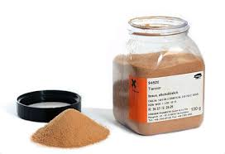
Properties : Tannins are non-crystallizable, amorphous compounds. They are soluble in water, ethyl alcohol, glycerol, acetone and in dilute alkalies. Their aqueous solution shows an acidic reaction and a sharp astringent taste. Most of the tannin compounds cause precipitation of solutions of alkaloids, glycosides, gelatin and heavy metal salts of copper, lead and tin. Tannins produce a deep red color with potassium ferricyanide and ammonia. With freshly prepared ferric chloride solution hydrolysable tannins produce blue-black precipitate while condensed tannins show brownish green precipitate.

Slide 13
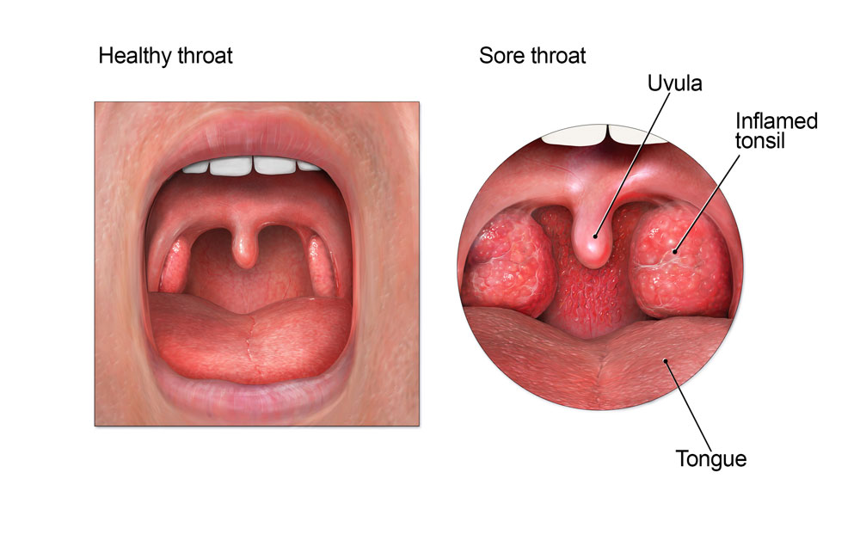
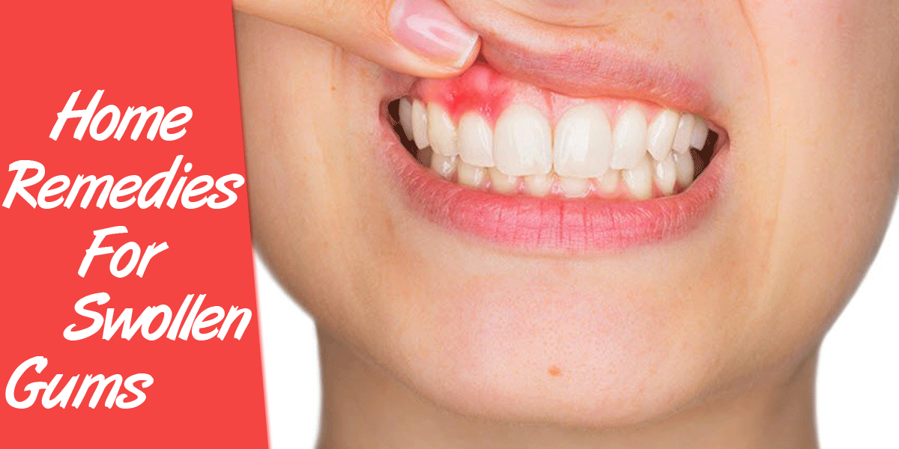
Medicinal uses:
Drugs containing tannins will precipitate proteins & Tannins are medicinally significant due to their astringent properties. They promote rapid healing and the formation of new tissues on wounds and inflamed mucosa. internally for inflamed surface of the mouth & Throat. They act as anti diarrhea & antidote in poisoning by heavy metals , alkaloids & glycosides . these compounds have demonstrated their antiviral activities for treatment of viral diseases including AIDS.

Slide 14
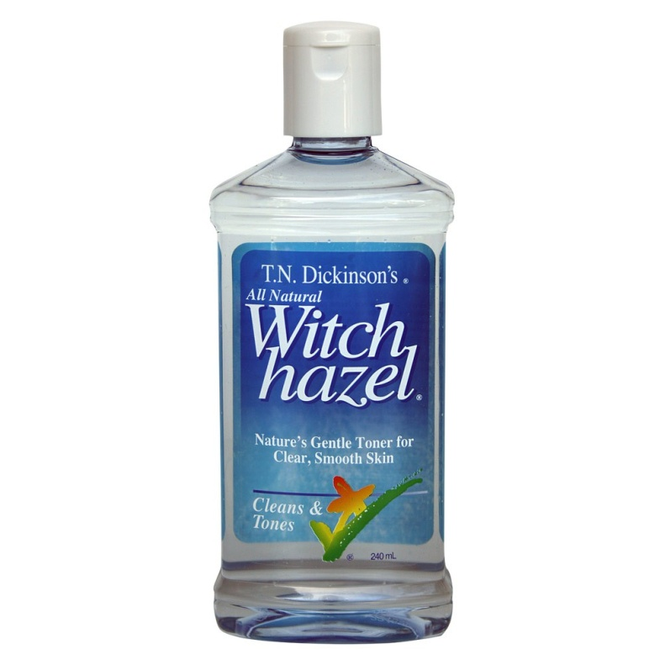
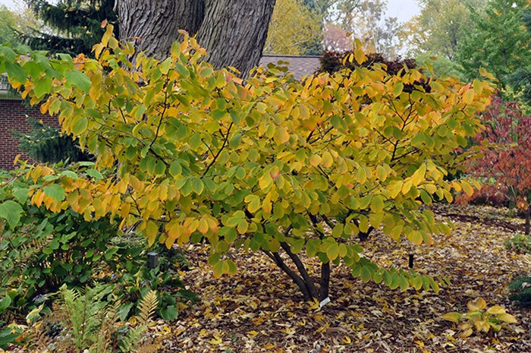
Plants containing tannins :
1- Hamamelis or witch hazel:
The dried leaves of Hamamelis virginiana they are collected in summer
The leaves contain
Gallitannin
Ellagitannin
free gallic acid
Uses: Have astriengent effect, also is reputed to: stop bleeding; soothe insect bites, burns, and poison ivy.

Slide 15
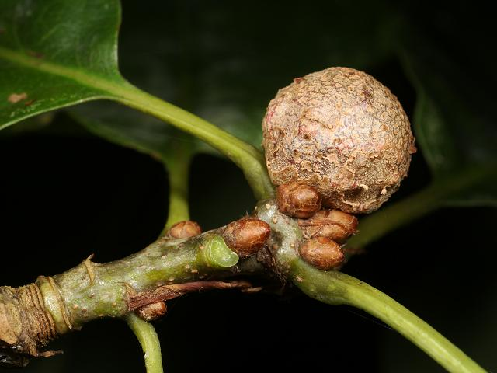
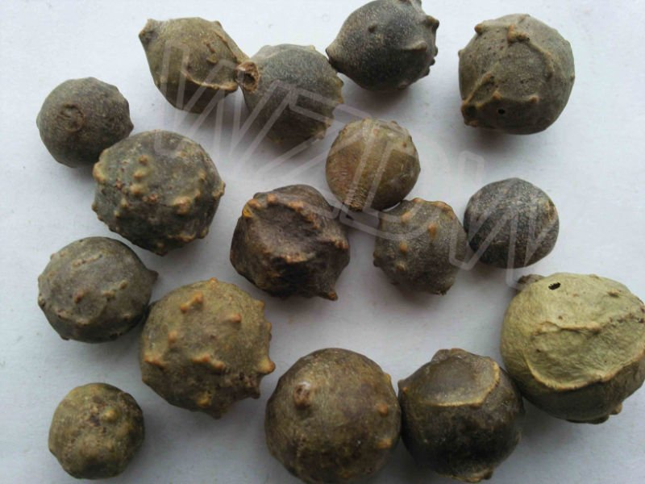
2- Nutgall or galls:
Quercus infectoria
is a plant excretion produced when irritants are released by the larvae of gall insects, such as those of the Cynipidae family, the gall wasps. A major commercial source of medicinal gallnuts is oak trees, The plant secretes the liquid gall, comprised mainly of tannins, that hardens to become the "nut." the main constituent is tannic acid (hydrolysable) & also contain gallic acid (pseudotannin) Nutgall is used in tanning & dyeing industry & in the manufacture of ink Medicinally it has a stringent effect .
Uses: Galls are astringent, and were used in all cases where astringents are indicated, as in chronic dysentery, diarrhea .

Slide 16
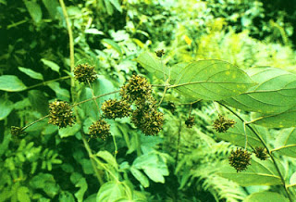
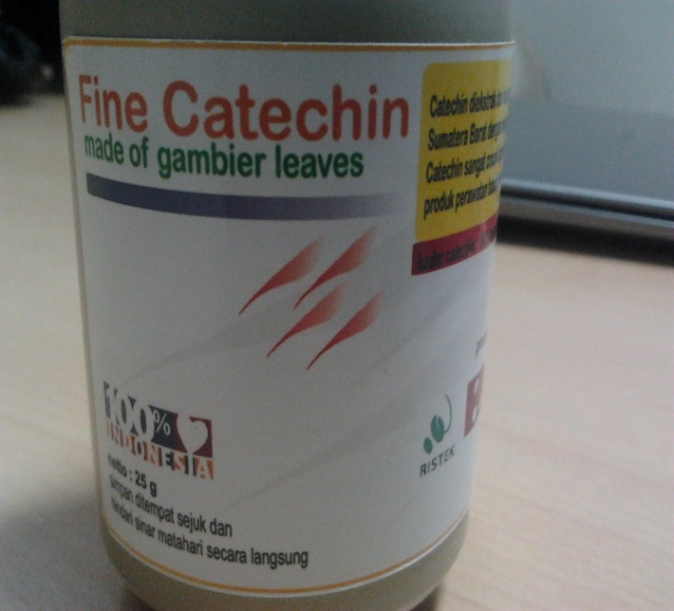
3- catechu: (Gambir)
Is the dried aqueous extract prepared from the leaves of young twigs of Uncaria gambir . It contains 7% catechin , 20% catechutannic acid . Used as a stringent .
Uses: Gambir contains polyphenol or catechins which work as antioxidant and antimicrobial.

Slide 17
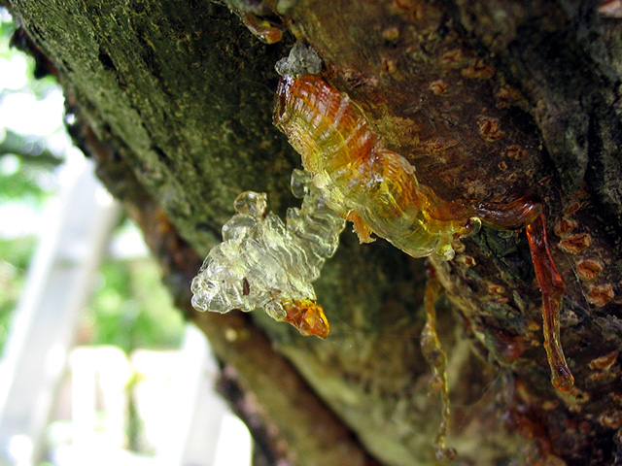
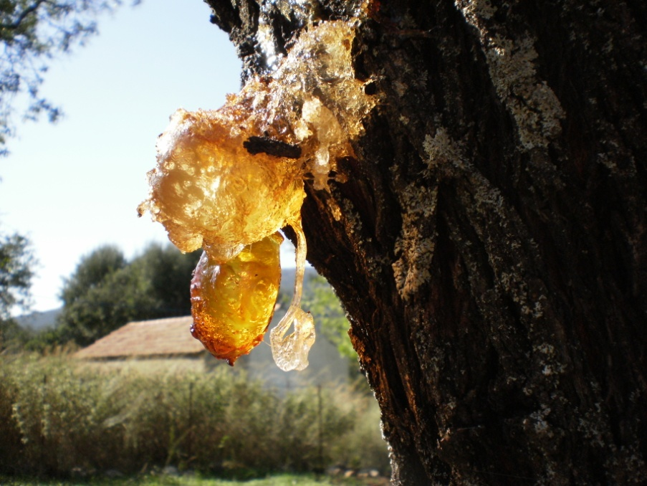
Resins and Resin Combination:
Resins are amorphous products of complex nature. These are amorphous mixtures of essential oils, oxygenated products of terpene and carboxylic acids found as exudations from the trunk of various trees. They are transparent or translucent solids, semi-solids or liquid substances containing large number of carbon atoms. Most of the resins are heavier than water. They are insoluble in water, but soluble in alcohol, volatile oils, fixed oils. non-polar organic solvents like benzene or ether. When heated, they soften and ultimately melt. They are usually formed in schizogenous or schizolysigenous cavities or ducts as end products of metabolism.

Slide 18
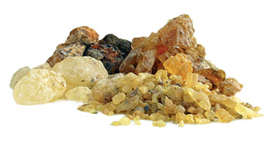
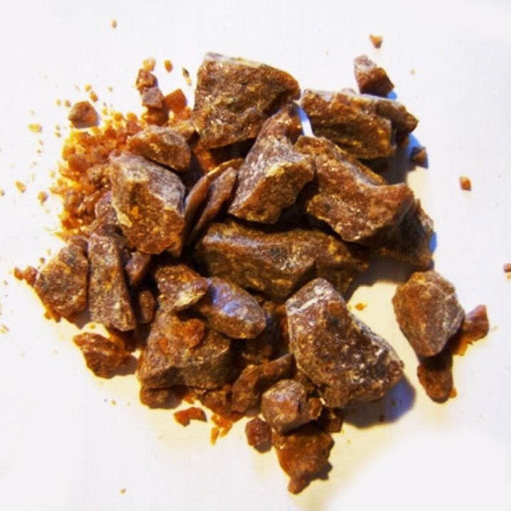
Chemically, they contain organic acids, alcohols, esters and neutral resins. Depending upon the type of the constituents of the resin, they are further classified as: acid resin, ester resin , resin alcohols,resenes which represent complex neutral compounds that do not form salts or esters & are insoluble & resist hydrolysis by alkali . Resins and oils in homogenous mixtures are called as oleoresins. Oleo-gum resins are the homogenous mixtures of volatile oil, gum and resin. If the resin contains benzoic acid and/ or cinnamic acid, it is called as a balsam.
The term “balsam” is often wrongly applied to oleoresins and should be reserved for such substances as balsam of Peru, balsam of Tolu and storax, which contain a high proportion of aromatic balsamic acids.

